Slide 1

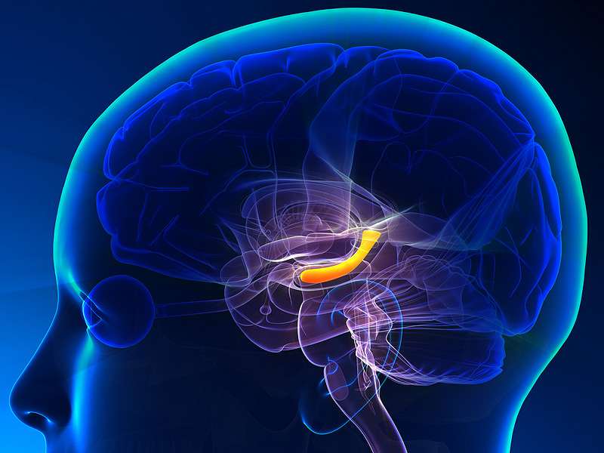
The hippocampus as a predictive map
Kimberly L Stachenfeld, Matthew M Botvinick & Samuel J Gershman
Qiang Lee
Institute of Biophysics， Chinese Academy of Sciences
Nove 11, 2017

Slide 2

Background

Slide 3




The Nobel Prize in Physiology or Medicine 2014
John O'Keefe
Born: 18 November 1939, New York, NY, USA
May-Britt Moser
Born: 4 January 1963, Fosnavåg, Norway
Edvard I. Moser
Born: 27 April 1962, Ålesund, Norway
for their discoveries of cells that constitute a positioning system in the brain

Slide 4
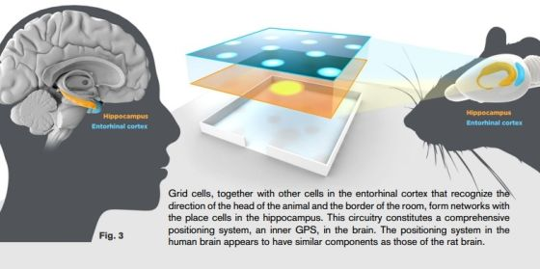
Human and Rat
Reproduced from Internet

Slide 5
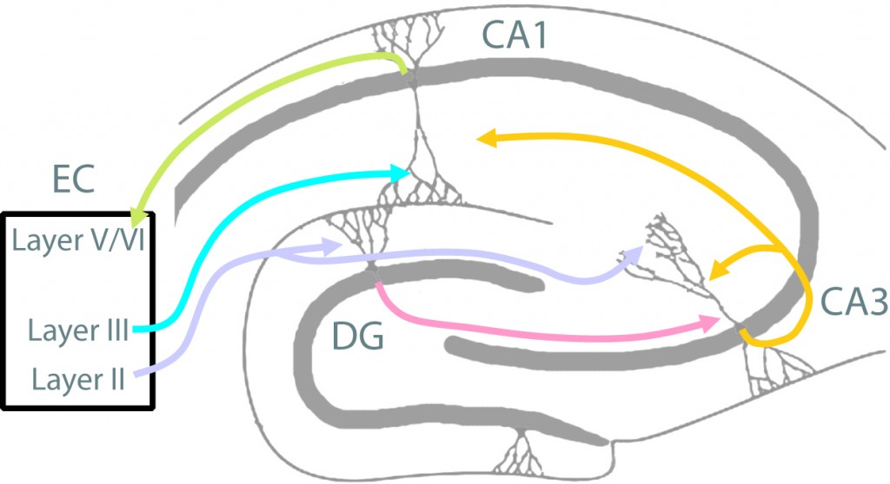
The Circuits of Hippocampus and entorhinal cortex in memory and learning
EC-Entorhinal Cortex DG-Dentate Gyrus
Reproduced from Neuro Circuits and Memoey Lab
http://neural circuits.uwm.edu/neural-circuits-of-the-hippocampus/

Slide 6
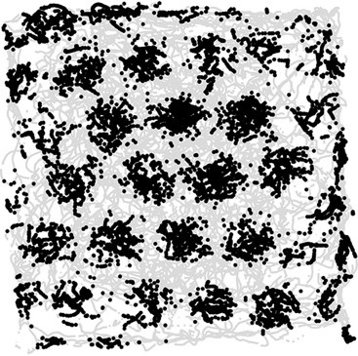
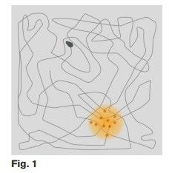
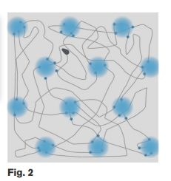
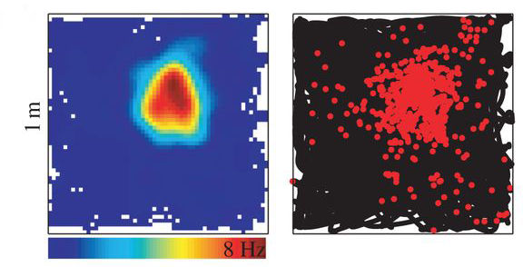
Grid Cell and Place Cell
Reproduced from Internet.

Slide 7
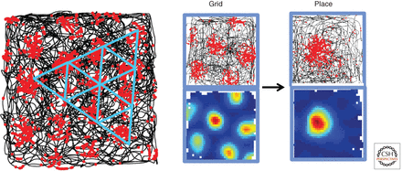
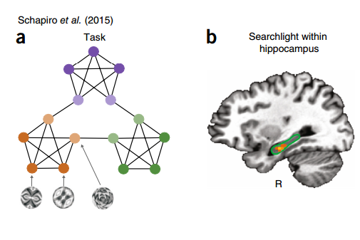
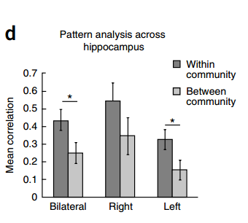
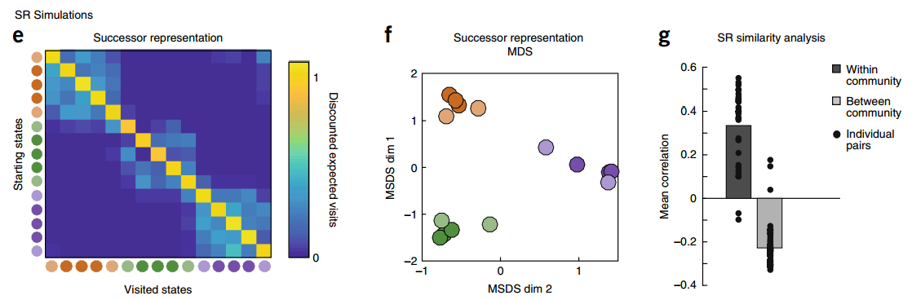
Reproduced from Kimberly L Stachenfeld et al. (2017) Nature Neuroscience.

Slide 8
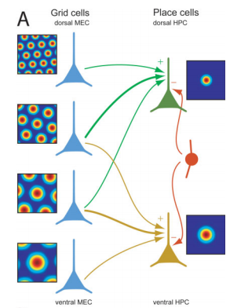
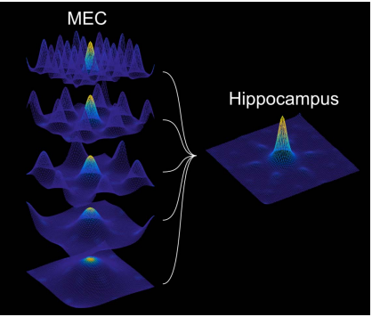
Transformation of neural codes
Reproduced from Solstad et al. (2006). Hippocampus 16:1026-1031

Slide 9
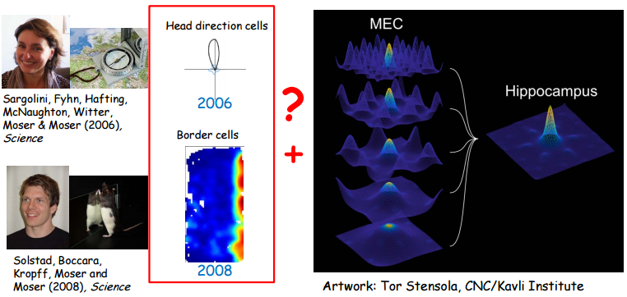
Transformation of neural codes
YES

Slide 10
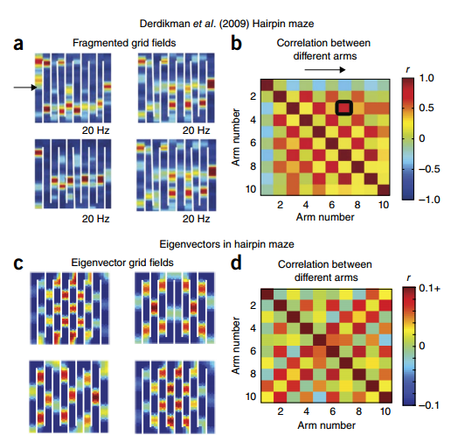
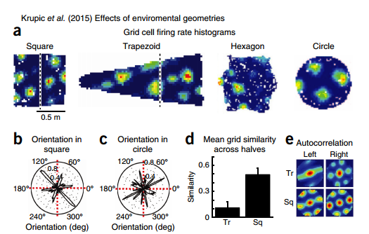
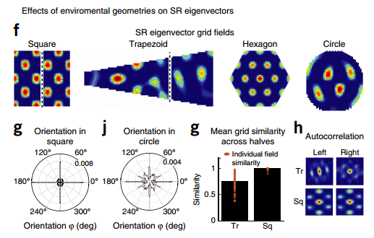
Reproduced from Kimberly L Stachenfeld et al. (2017) Nature Neuroscience.

Slide 11

View: the function of Hippocampus
The hippocampus as a cognitive map
The hippocampus as a predictive map

Slide 12
Reinforcement Learning (RL) model
Simulating the function of Hippocampus

Slide 13

The successor representation
Reproduced from Internet

Slide 14
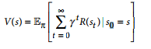
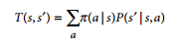
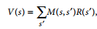
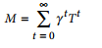
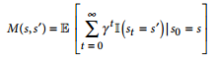
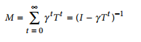
The successor representation
V(s):value functions in spatial RL
S: current state, S': future state, gamma: discount factor[0,1]

Slide 15
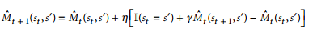
M(s,s`) = 1 if s = s`, and M(s,s`) = 0 if s ≠s`

Slide 16
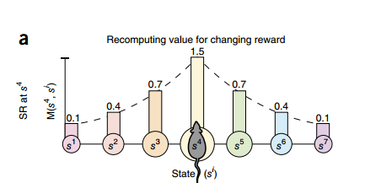
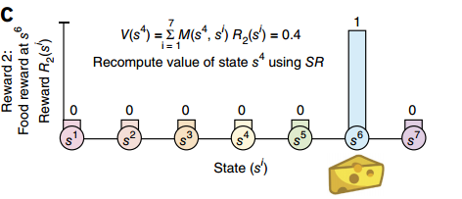
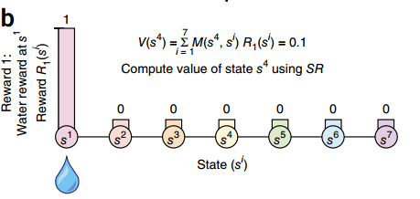
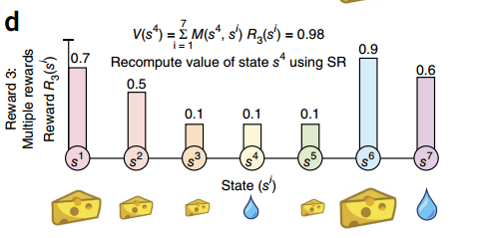

Slide 17
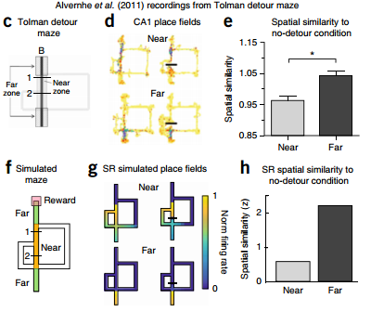
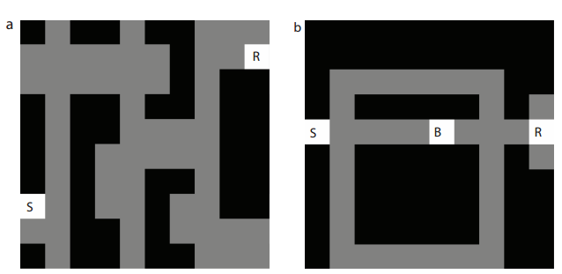
Grid-world representation of Tolman’s tasks.
Reproduced from EM.(2016). bioRxiv.doi: http://dx.doi.org/10.1101/083857

Slide 18
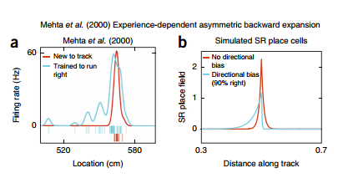
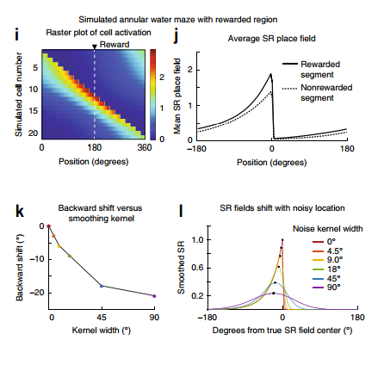
Reproduced from Kimberly L Stachenfeld et al. (2017) Nature Neuroscience.

Slide 19
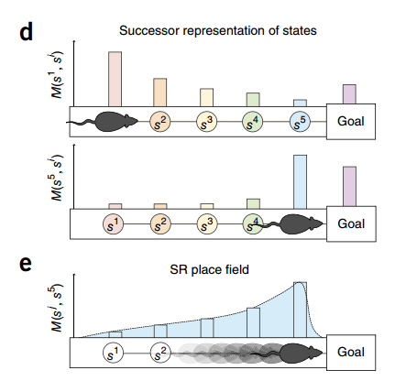
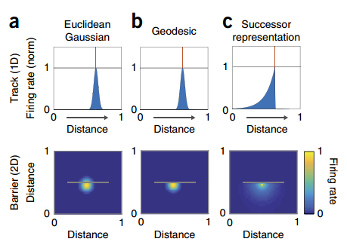

Slide 20
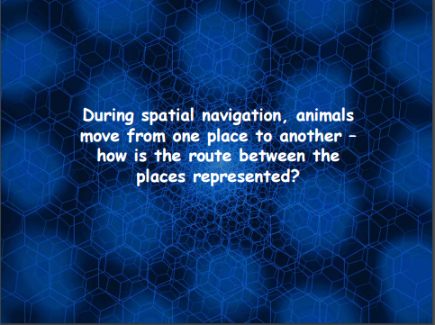


Slide 21
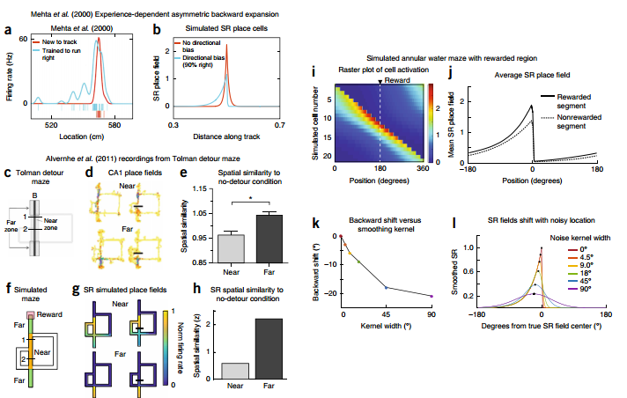
Reproduced from Kimberly L Stachenfeld et al.(2017). Nature Neuroscience

Slide 22
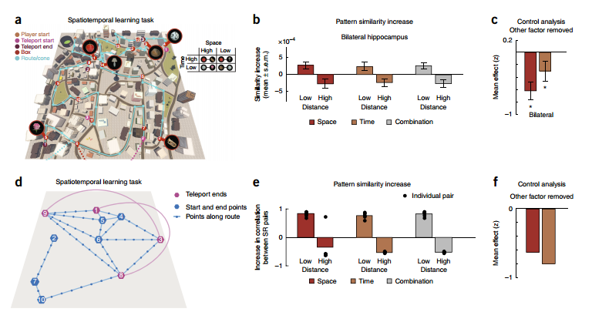
Conclusion: we argue that entorhinal grid cells encode a low-dimensionality basis set for the predictive
representation, useful for suppressing noise in predictions and extracting multiscale structure for hierarchical planning.

Slide 23
Neuroscience and Deep learning (AI)

Slide 24
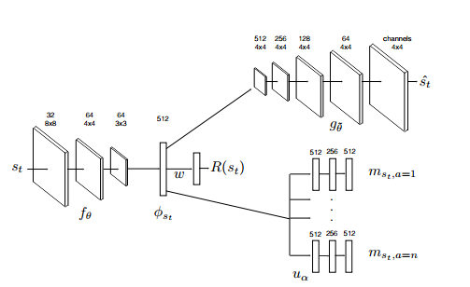

Deep Successor Reinforcement Learning
Model Architecture
Reproduced from arXiv.org:1606.02396

Slide 25
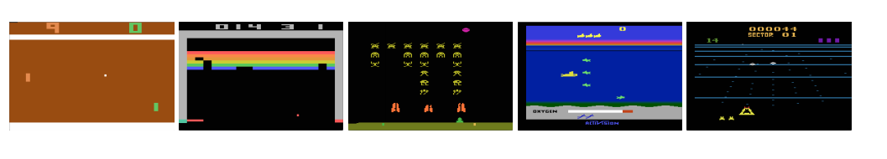
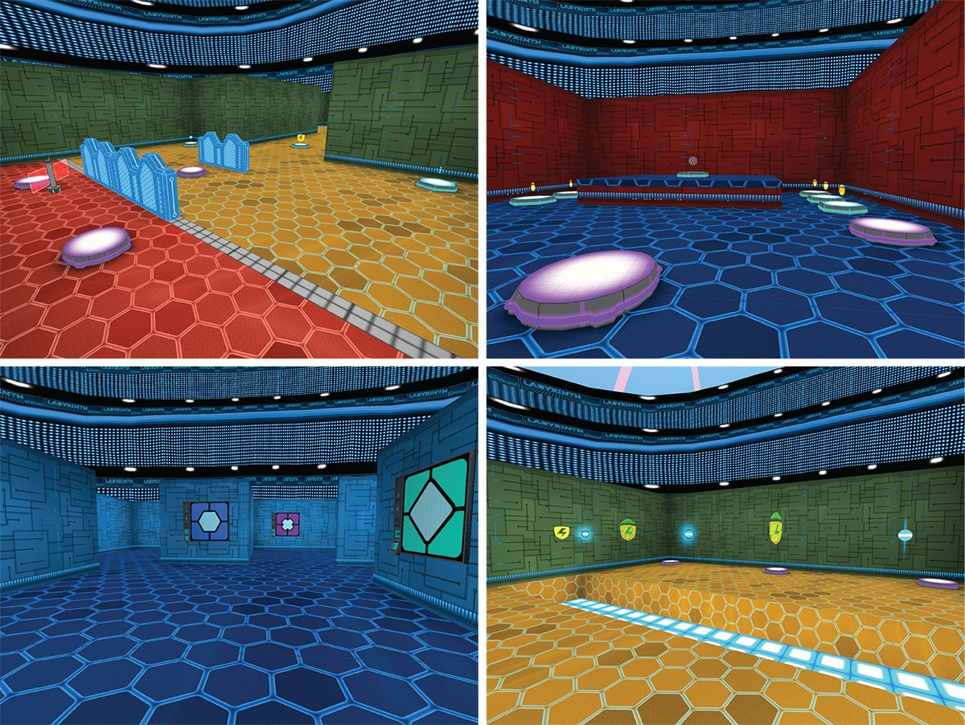

Playing Atari with Deep Reinforcement Learning

Slide 26
Thanks for your kind attenation
&&
see you soon

Slide 27
Statistical Learning of Temporal Community Structure in the Hippocampus
Anna C. Schapiro,* Nicholas B. Turk-Browne, Kenneth A. Norman, and Matthew M. Botvinick
Qiang Lee
Institute of Biophysics， Chinese Academy of Sciences
Nove 18.2017

Slide 28

Author Info:
I am interested in how we learn and represent information in our environment, especially structured information with temporal or semantic relationships that require integration over time. My research has explored the initial stages of acquiring such information as well as the offline consolidation processes that shape initial memory representations for longer term storage and use. I am now developing a neural network model of learning and hippocampal-cortical interactions during sleep.

Slide 29
the world seems to divide naturally into discrete, temporally extended events,

Slide 30

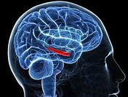


Research Question?
The hippocampus is involved in the learning and representation of temporal statistics, but little is understood about the kinds of statistics it can uncover.
The Picture from Internet

Slide 31
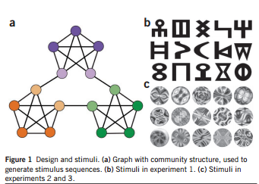
Expermient Design
Reproduced from Schapiro, et al.(2013) Nature Neuroscience

Slide 32
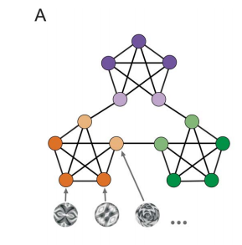
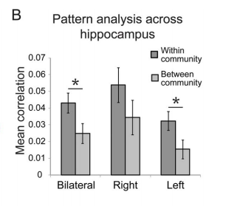
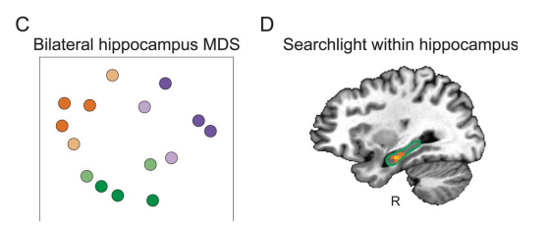
temporal structure
Community Structure
visual stimulus was assigned to each node and the edges represent possible transitions between stimuli.
Overlap and distribution
Reproduced from Schapiro,et al.(2015) Hippocampus

Slide 33
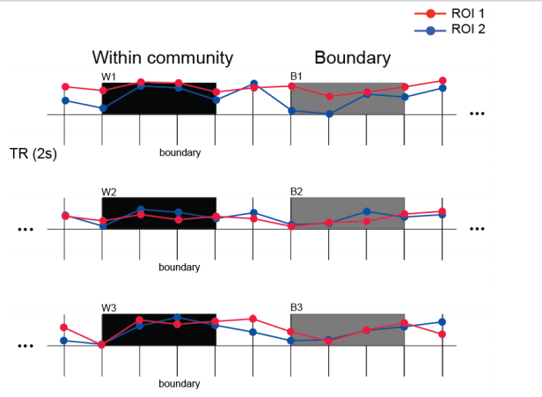
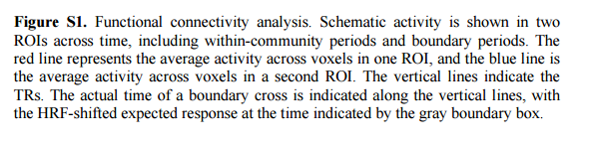
Reproduced from Schapiro,et al.(2015) Hippocampus

Slide 34
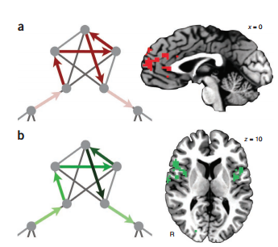
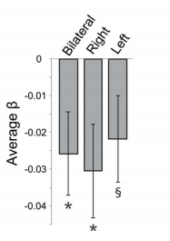
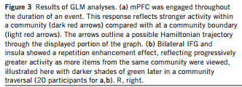
Boundary Effect
Reproduced from Schapiro, et al.(2015) Hippocampus

Slide 35

Background Connectivity
Reproduced from Schapiro, et al.(2015) Hippocampus

Slide 36
Conclusion:
1. the hippocampus is indeed sensitive to this form of structure, as revealed by its representations, activity dynamics, and connectivity with other regions.
2. the hippocampus is a sophisticated learner of environmental regularities, able to uncover higher-order structure that requires sensitivity to overlapping associations

Slide 37
Thanks for your kind attenation
&&
see you soon

Slide 38
Recently My Research Report

Slide 39


Glass Brain
T-Maps

Slide 40


T-Maps and Threshold-Maps

Slide 41




Slide 42
Classification Result based on Different Masks

Slide 43
Quantifying Interindividual Variability and Asymmetry of Face-selective Regions: A Probabilistic Functional Atlas
Neuroimaging Journal

Slide 44




Slide 45




Slide 46




Slide 47




Slide 48




Slide 49




Slide 50




Slide 51




Slide 52




Slide 53




Slide 54




Slide 55




Slide 56
Classification Results based on My Own Masks

Slide 57



Notes: All coordinates in the Left Picture(x,y,z)

Slide 58





Slide 59





Slide 60





Slide 61





Slide 62


Experiment Ideas
Result

Slide 63

Wrarun1-session1
The Matrix of Brain Connectivity

Slide 64

Wrarun2-session2
The Matrix of Brain Connectivity

Slide 65

Wrarun3-session3
The Matrix of Brain Connectivity

Slide 66

Wrarun4-session4
The Matrix of Brain Connectivity

Slide 67

Wrarun5-session5
The Matrix of Brain Connectivity

Slide 68

Wrarun6-session6
The Matrix of Brain Connectivity

Slide 69

More Good staffs will come soon!

